Slide 1


Air Pollution
By- PRATIK BT23CSA010
ADITYA BT23CSA029

Slide 2
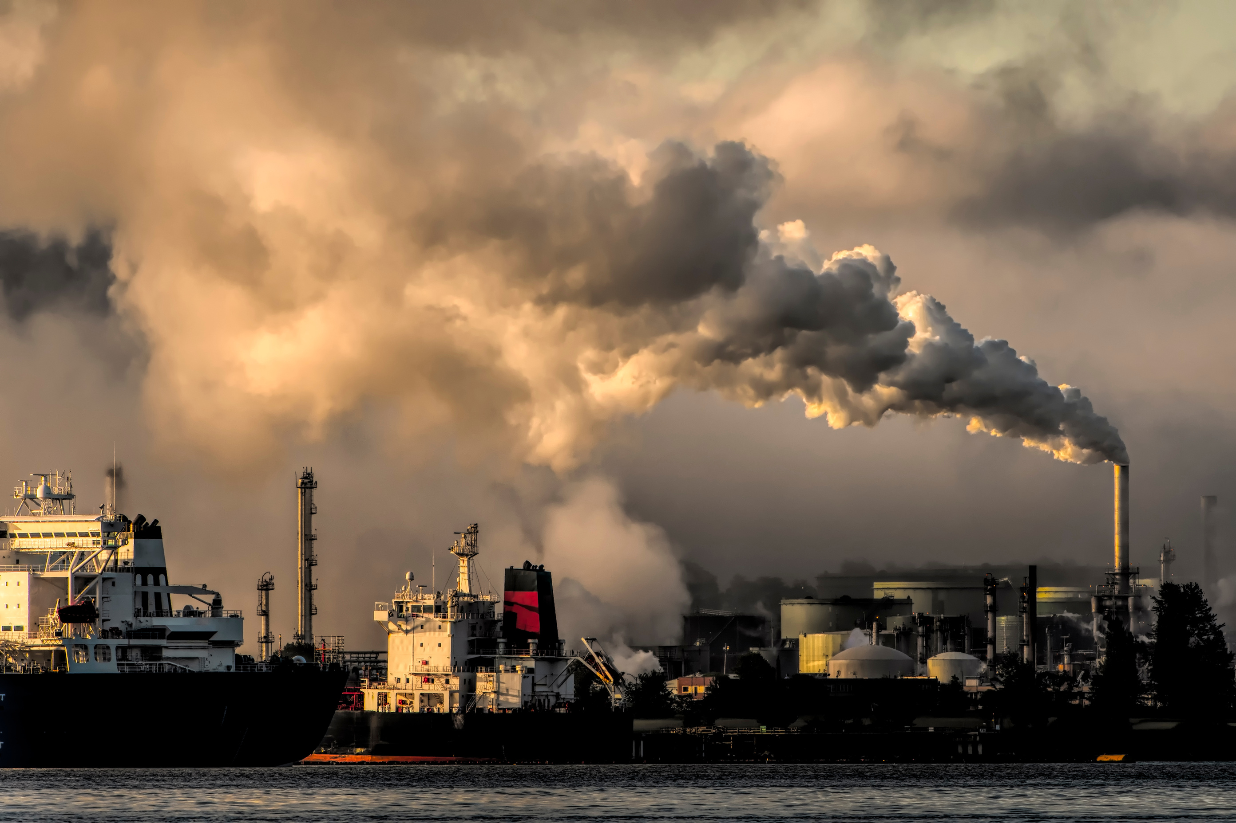
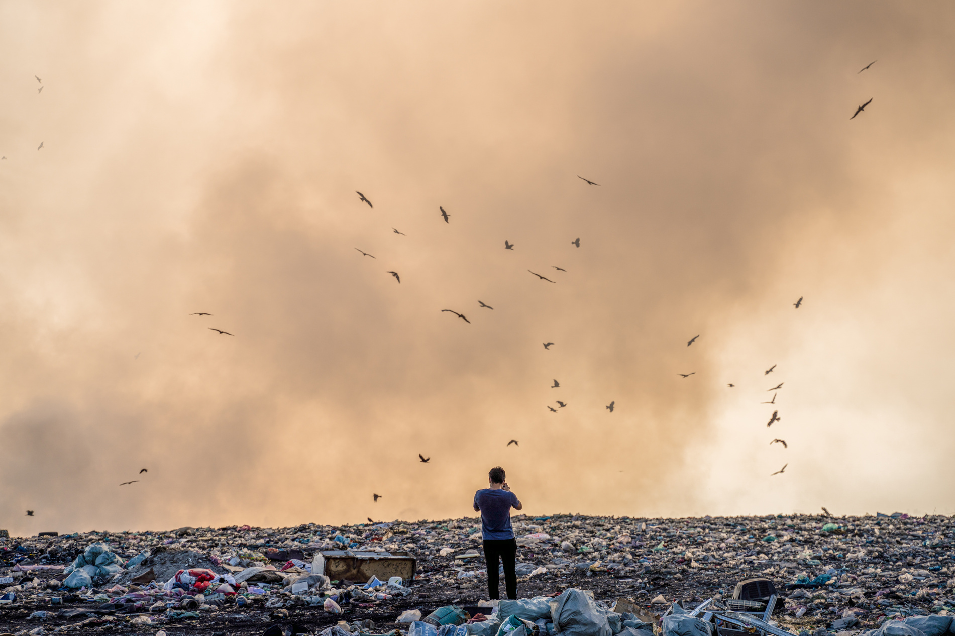
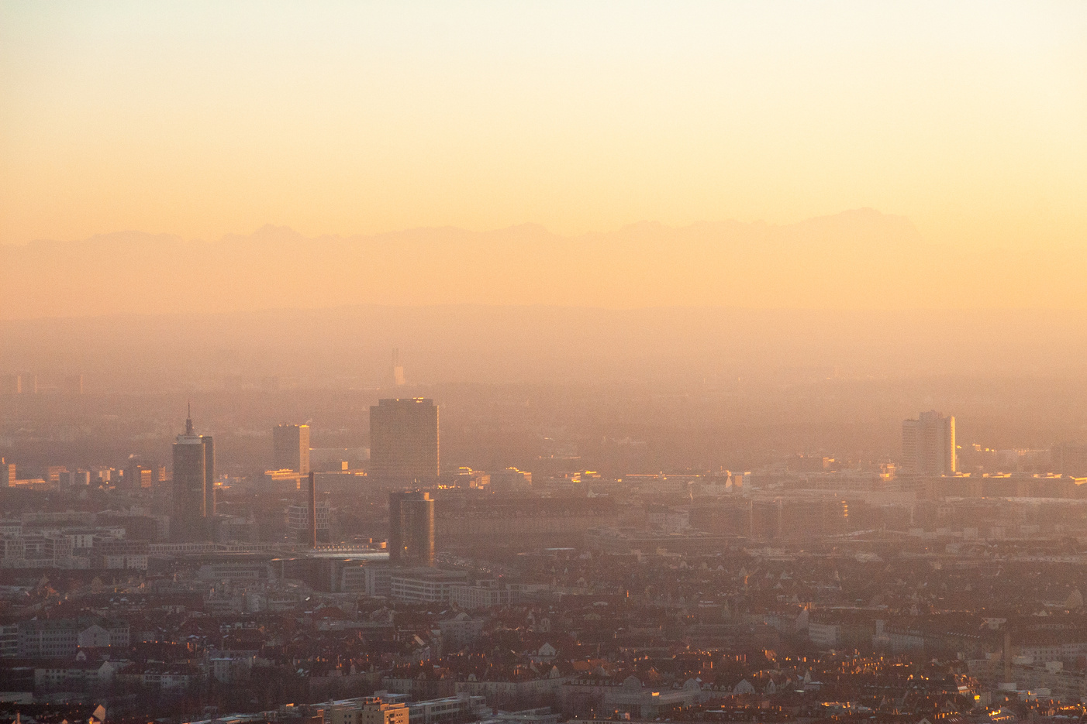
What is Air Pollution?
Introduction
~Air pollution is one of the most critical environmental issues facing India today.
~Rapid urbanization, industrialization, and increasing vehicle emissions have led to poor air quality in many Indian cities.
~Exposure to high levels of pollutants such as PM2.5, PM10, NO₂, and SO₂ has severe health impacts.

Slide 3
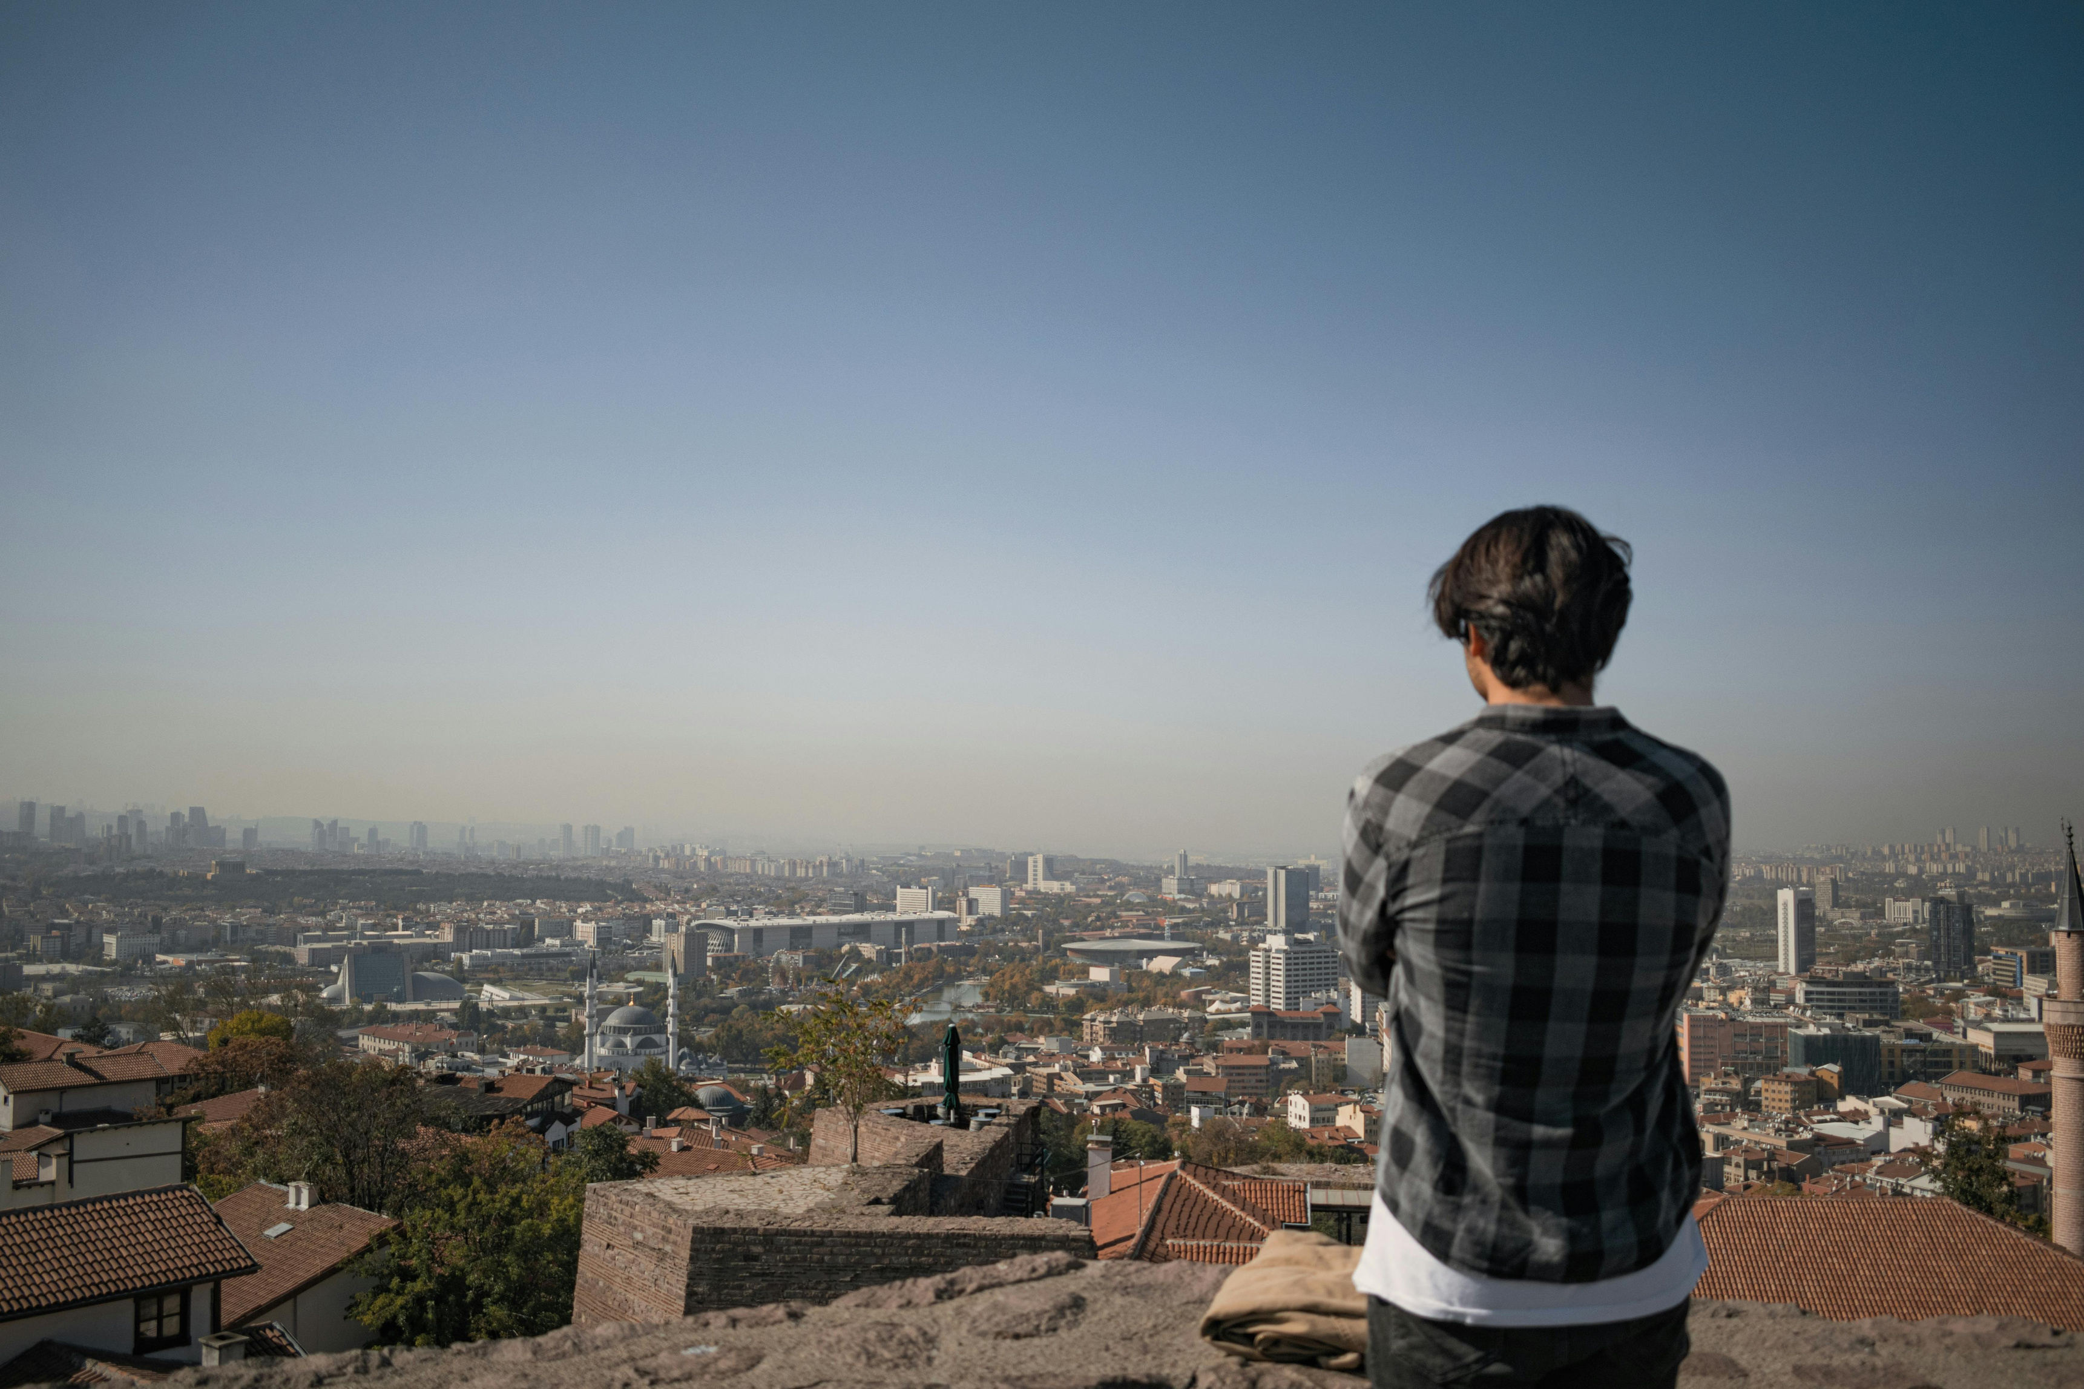
Problem Description
~Air pollution is a growing concern in India, with several cities consistently ranking among the most polluted in the world.
~Despite the availability of air quality data, it often remains underutilized due to a lack of proper analysis and visualization.
Challenges include: ~Large and complex datasets with missing or inconsistent values.
~Difficulty in identifying trends and drawing actionable insights from raw data .
~Limited public accessibility to intuitive, data-driven tools for understanding pollution patterns.
This project aims to solve these problems by:
~Cleaning and analyzing air pollution data across multiple Indian cities.
~Identifying pollution hotspots, seasonal trends, and pollutant patterns.
~Presenting insights through a user-friendly Power BI dashboard to support public awareness and policy planning.

Slide 4
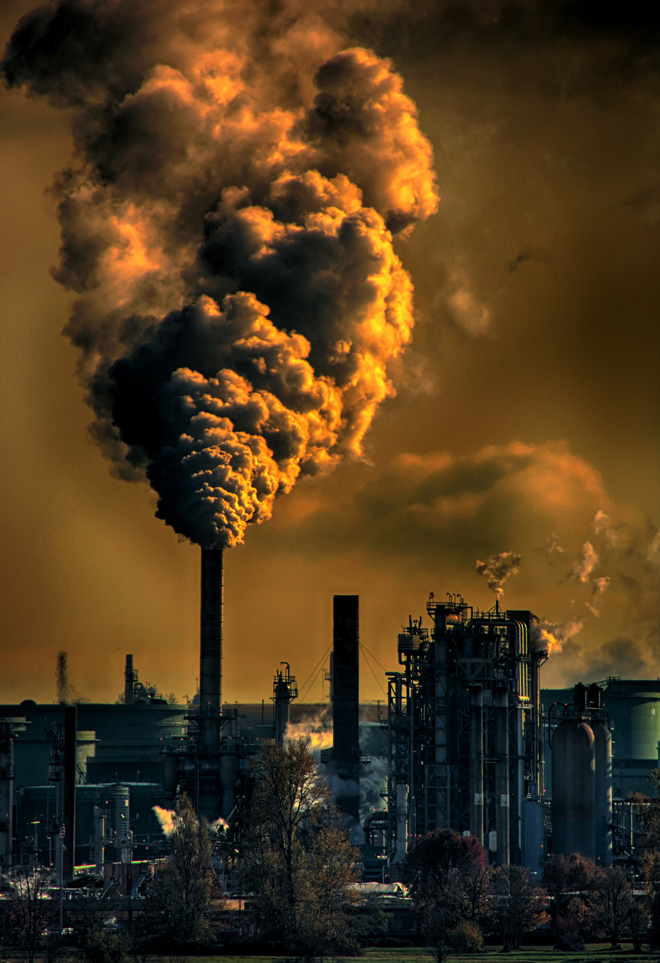
Objective of This Project
~Analyze historical air pollution data across Indian cities.
~Extract meaningful patterns and trends using Exploratory Data Analysis (EDA).
~Visualize insights through an interactive Power BI dashboard for better understanding and decision-making.

Slide 5
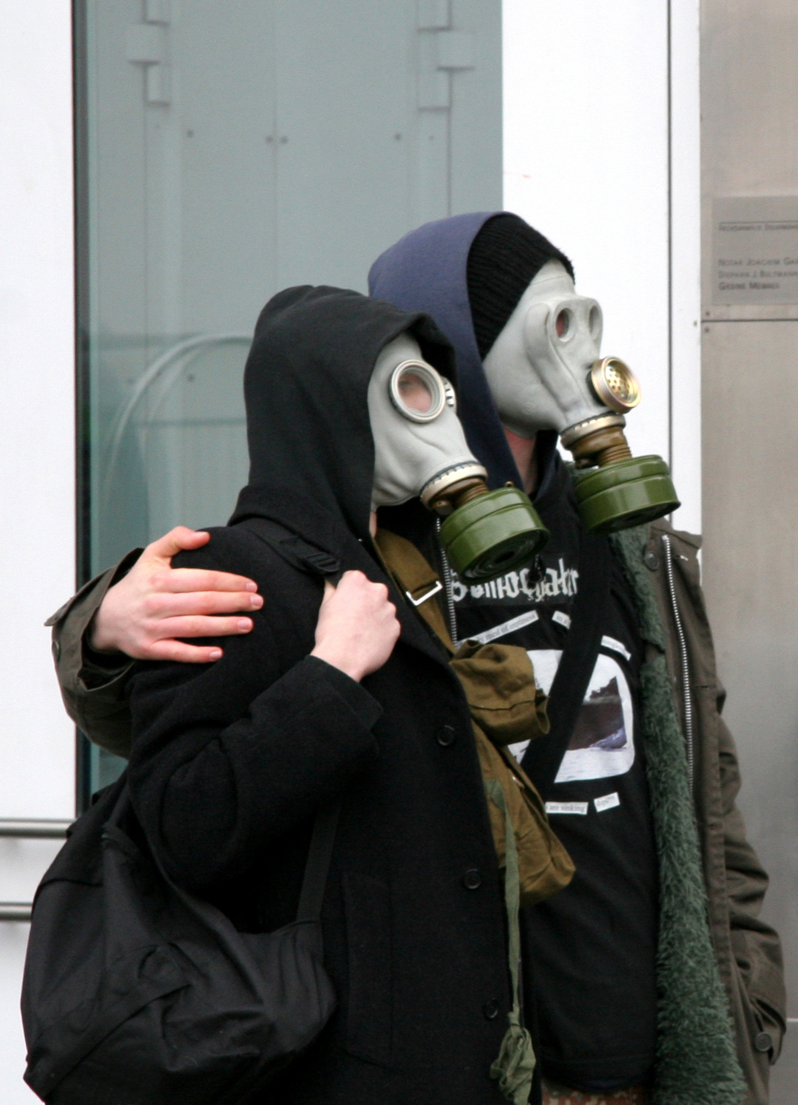
~The dataset contains air pollution data collected from various monitoring stations across Indian cities.
Key Features:
~City – Name of the city where data was recorded.
~State – Corresponding state for each city.
~Date – Date of observation.
~SO₂ (Sulphur Dioxide) – Concentration in µg/m³.
~NO₂ (Nitrogen Dioxide) – Concentration in µg/m³.
~Location – Specific area or locality within the city.
~Monitoring Station – Name or code of the air quality monitoring station.
~Agency – Organization or department responsible for data collection (e.g., CPCB, SPCB).
~Data Source: Central Pollution Control Board (CPCB), Kaggle, Government Open Data Portals.
~Time Range: 1999 – 2000
Dataset Description

Slide 6
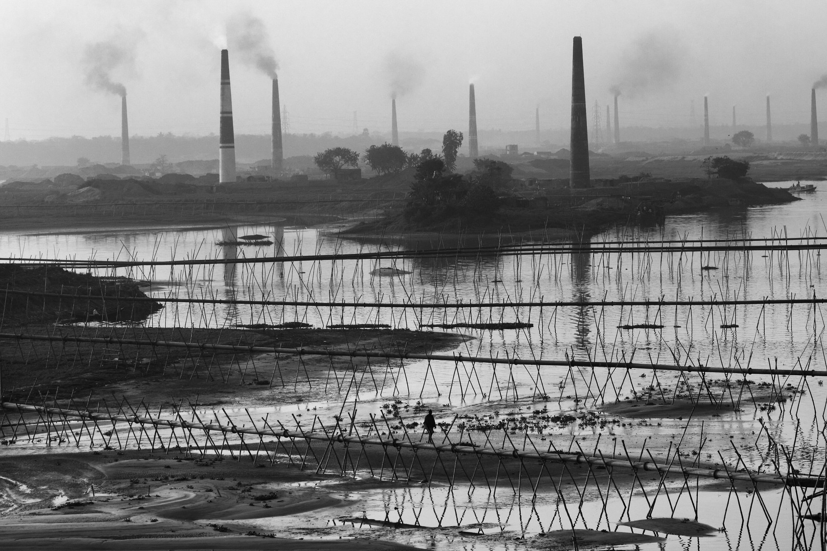
1. Loading the Data:-
~Imported raw data using Python (pandas).
~Combined multiple CSV files (if applicable).
2. Handling Missing Values:-
~Identified null or missing entries in pollutant concentrations.
~Used methods like forward fill, mean imputation, or row removal based on context.
3.Date Formatting:-
~Converted date column to datetime format.
~Extracted useful parts like year, month, and day for time-based analysis.
4.Standardizing Column Names:-
~Renamed columns for consistency and readability.
5. Filtering Relevant Data:-
~Removed cities or records with insufficient data.
~Focused on selected pollutants and valid monitoring stations.
6.Encoding Categorical Variables (if needed):-
~Converted text-based columns (like city or agency) into categorical types for performance.
Data Wrangling / Pre-processing Steps
Ecosystem Disruption
Pollutants like heavy metals and pesticides accumulate in the environment, disrupting food chains and affecting wildlife health. Poor air quality stunts plant growth, reducing biodiversity and agricultural output.

Slide 7
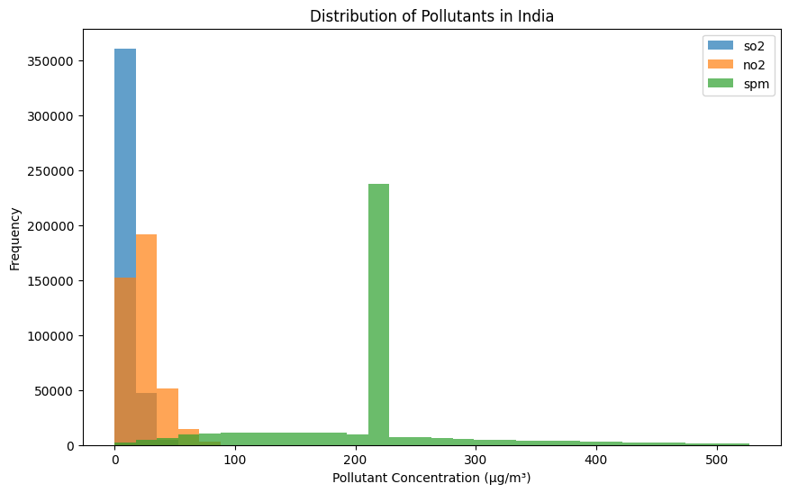
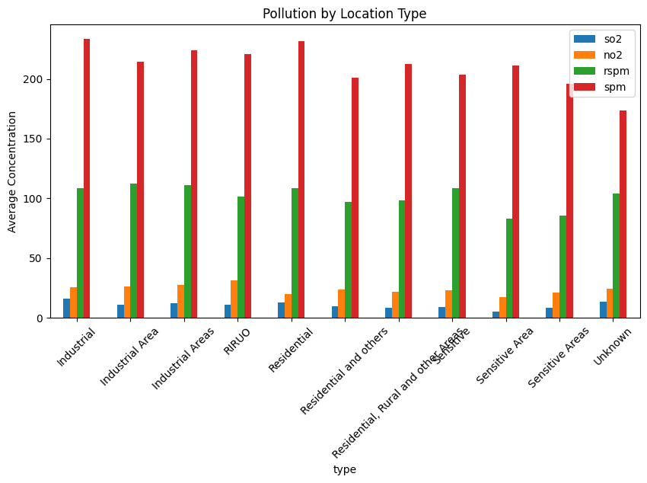
Exporting Cleaned Data

Slide 8
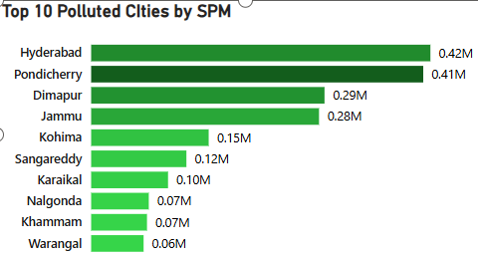
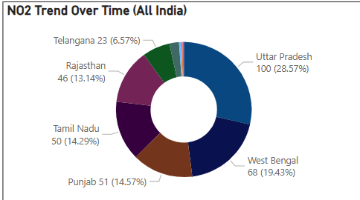
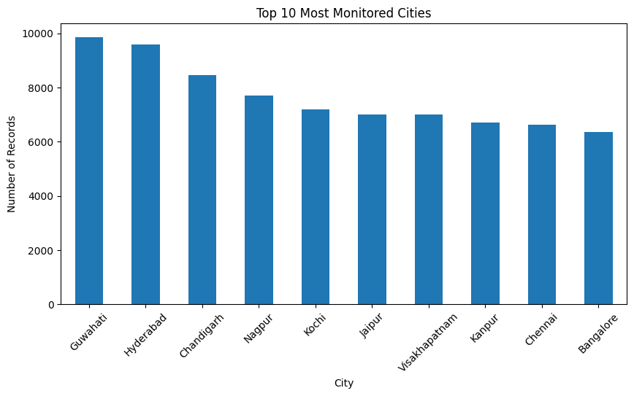
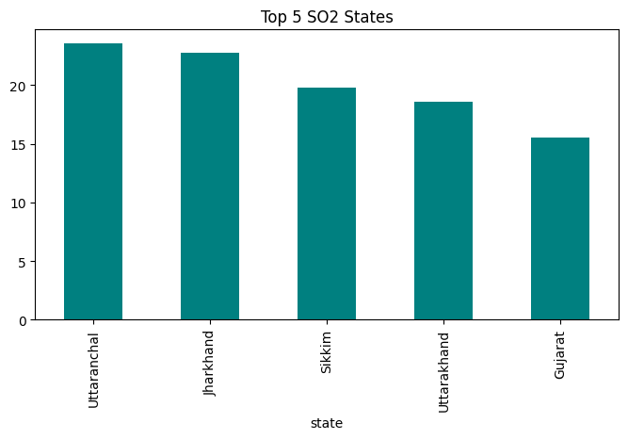

Slide 9
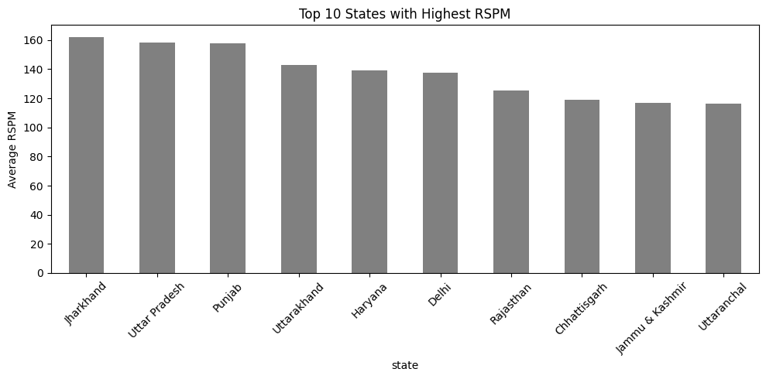
Some Imp Questions
Q] States with highest RSPM?

Slide 10
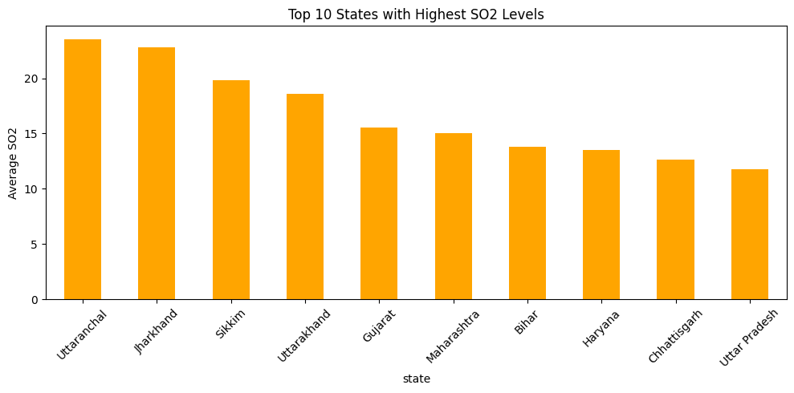
Q] Which states have the highest average SO2 levels?

Slide 11
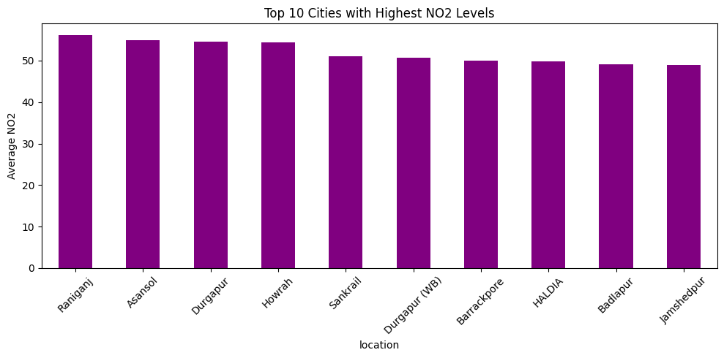
Q] Which cities have the highest NO2 levels?

Slide 12
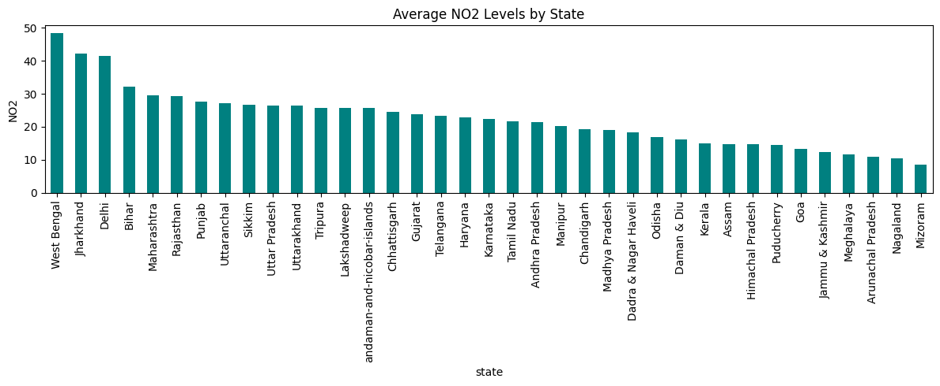
Q] What are the average NO2 levels per state?

Slide 13
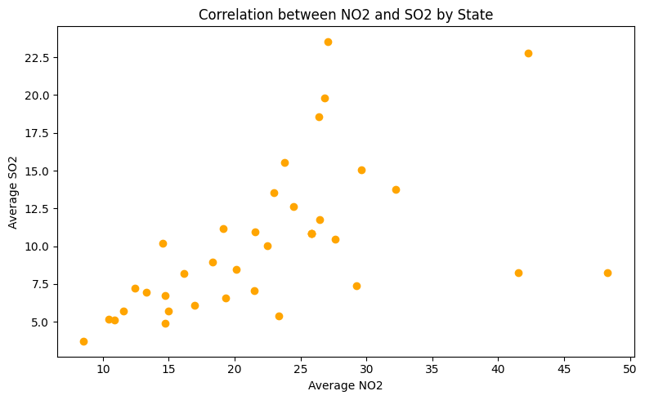
Q] State-wise correlation between NO2 and SO2?

Slide 14
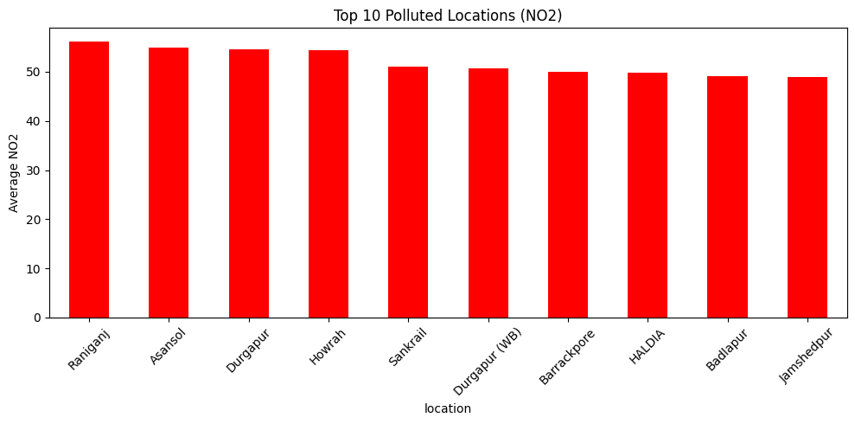
Q] Top 10 polluted locations based on NO2?

Slide 15
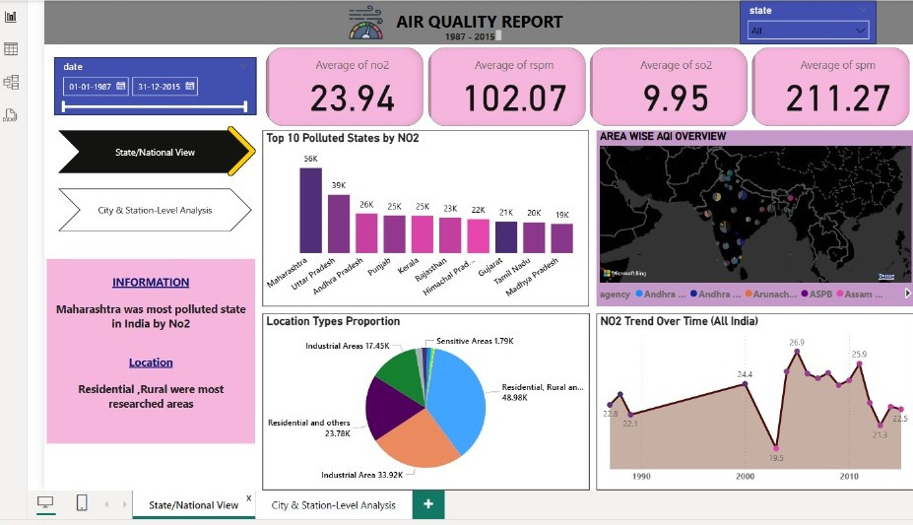
PowerBI Dashboard

Slide 16
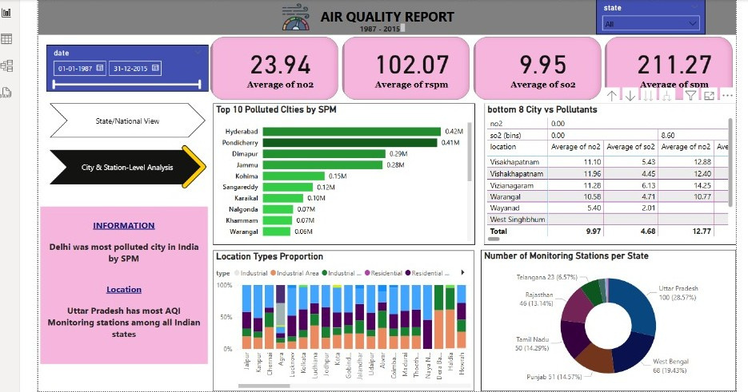
PowerBI Dashboard

Slide 17
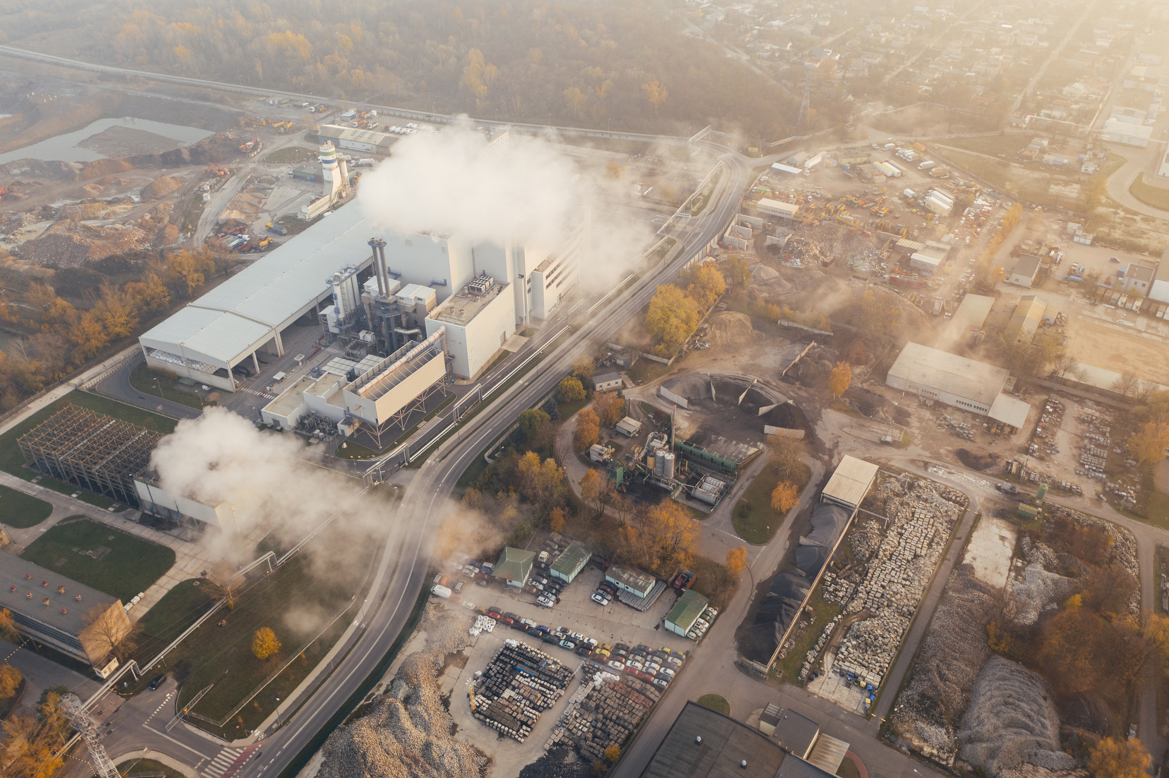
References
1.Central Pollution Control Board (CPCB)
https://cpcb.nic.in
2.Kaggle – Air Pollution Dataset (India)
https://www.kaggle.com
3.National Air Quality Monitoring Programme (NAMP)
https://app.cpcbccr.com/ccr/#/caaqm-dashboard
4.Ministry of Environment, Forest and Climate Change, India
https://moef.gov.in

Slide 18
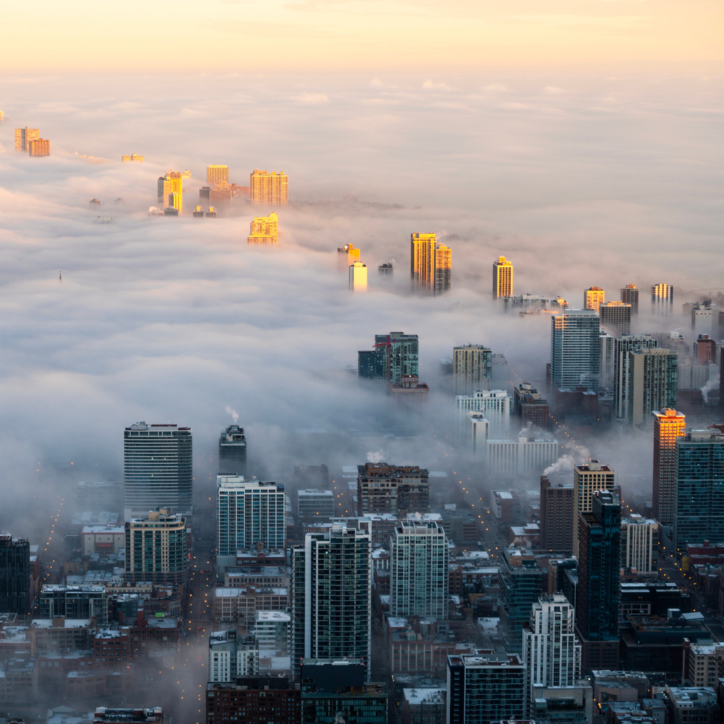
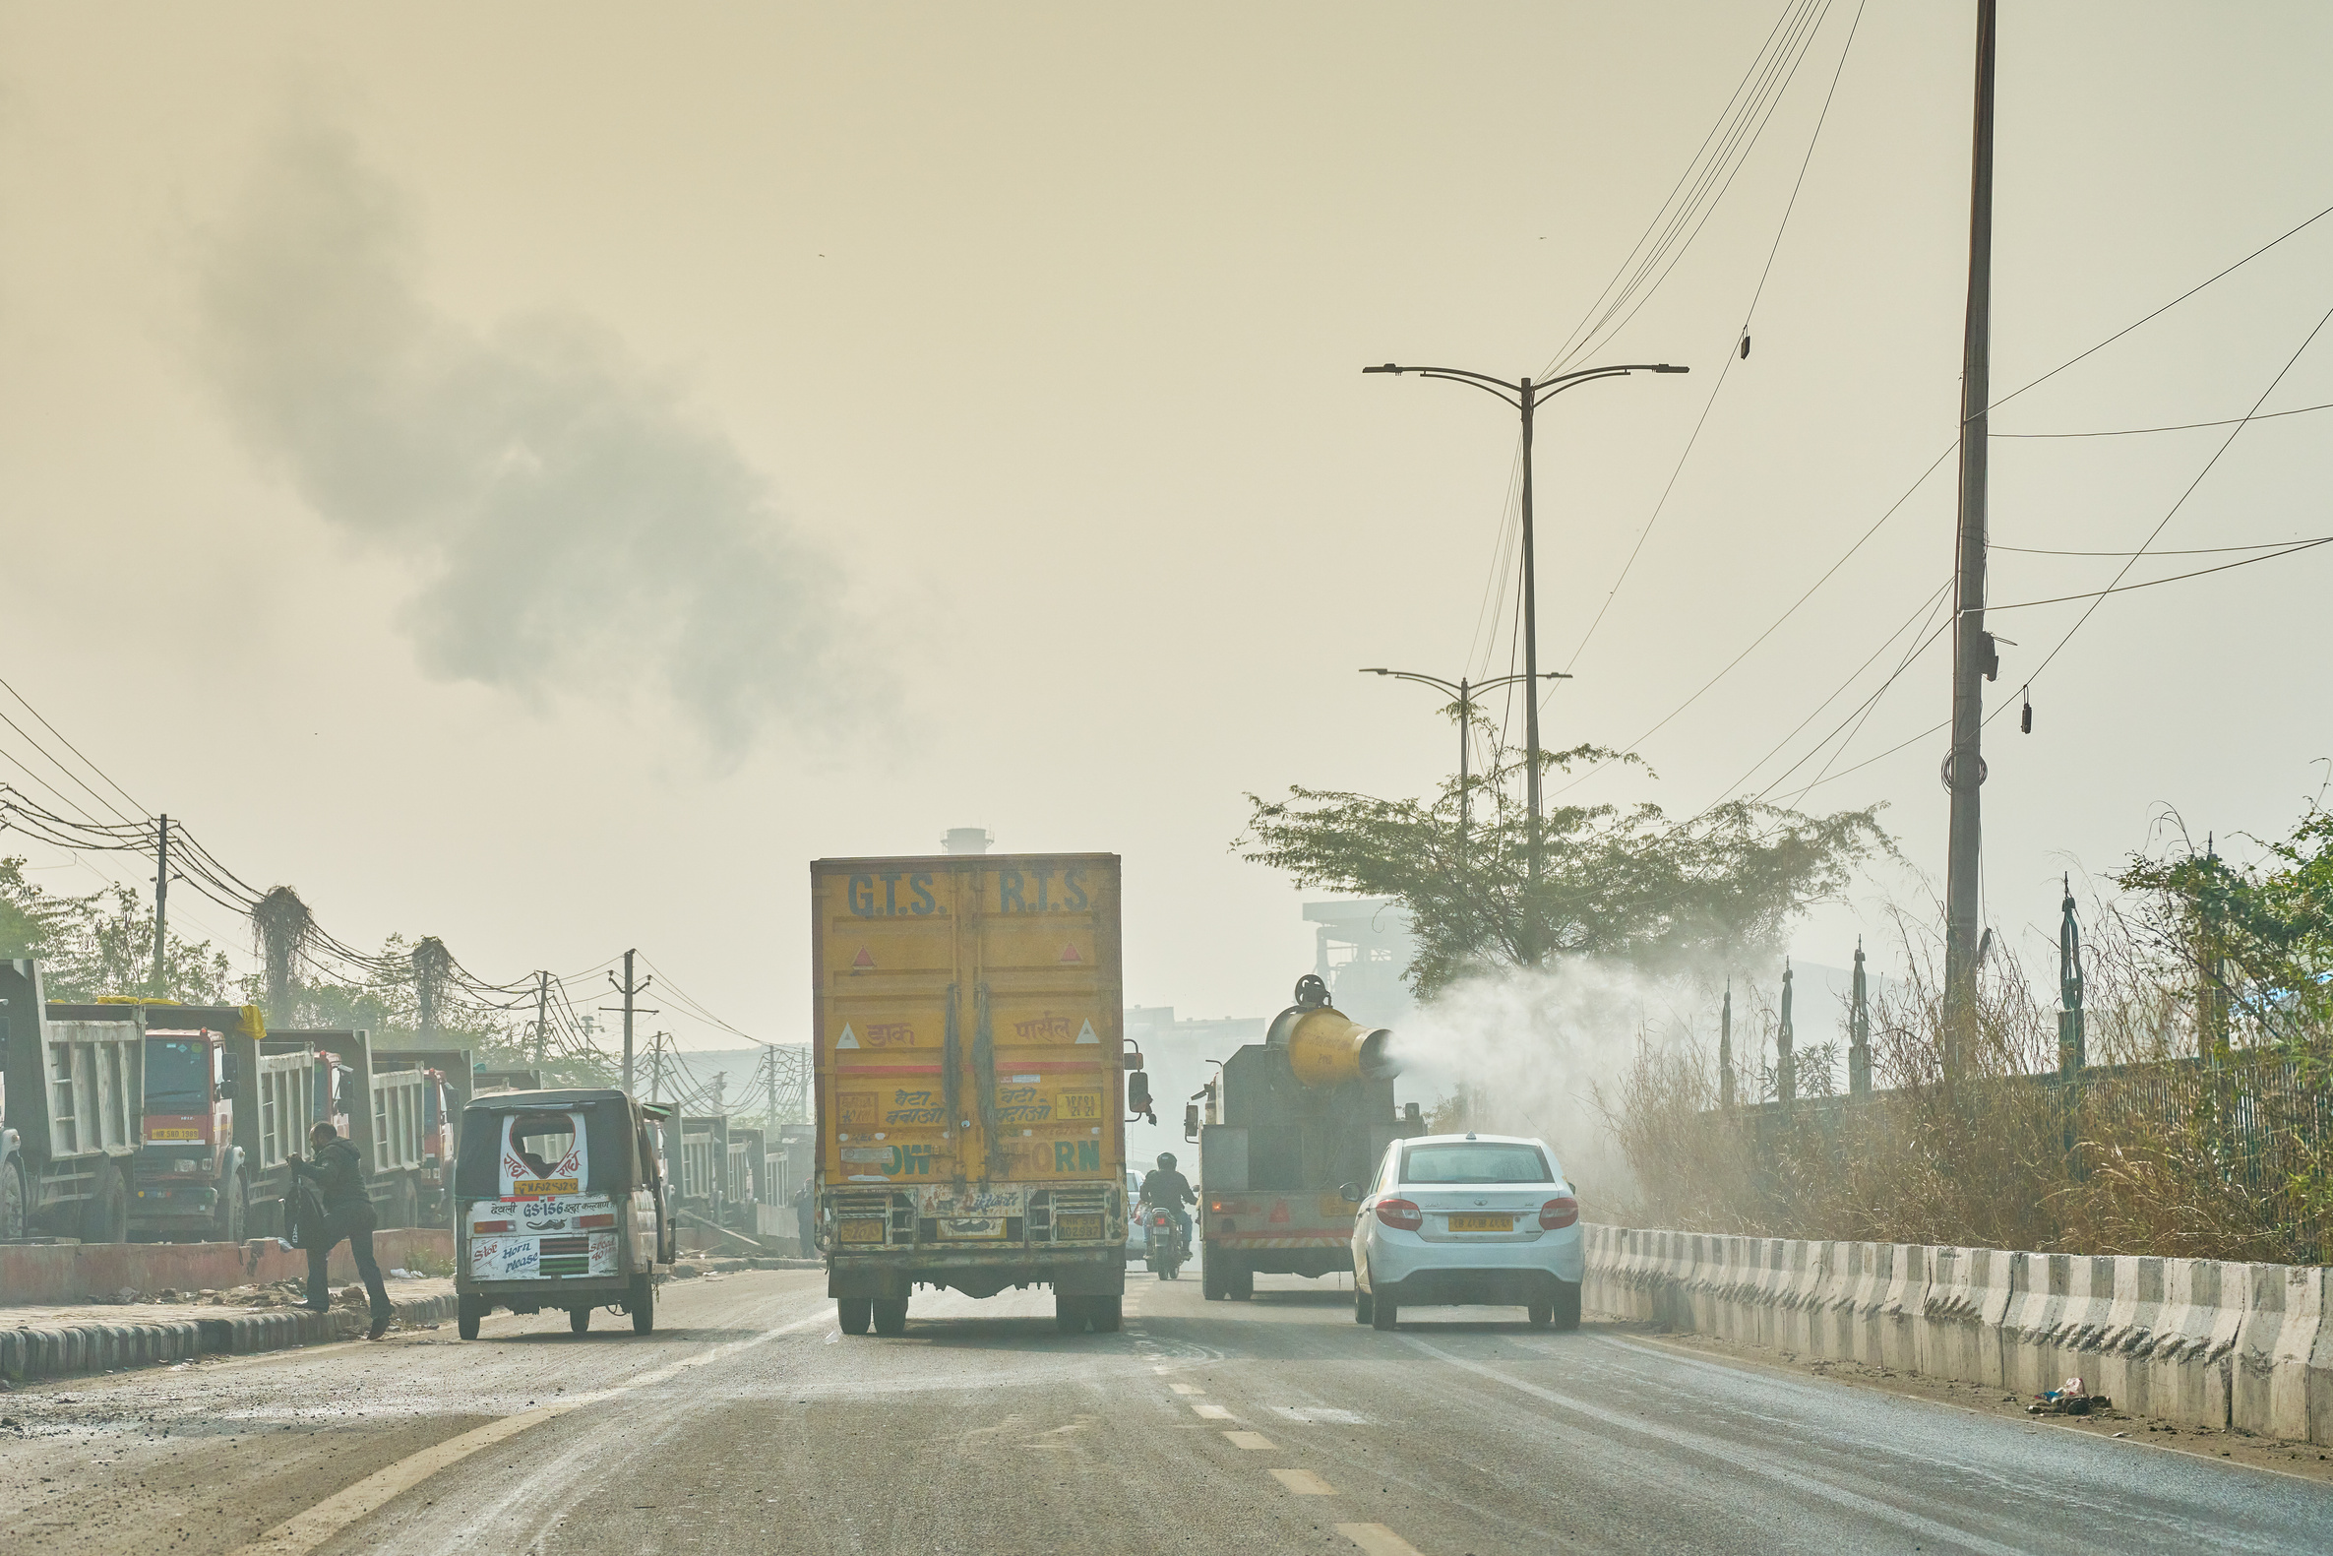
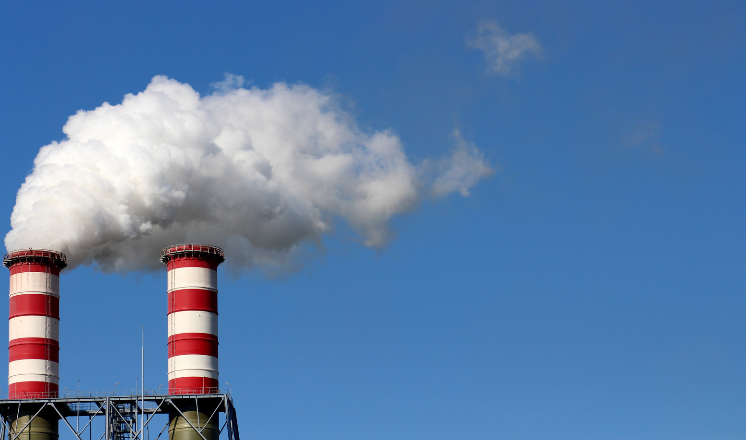
Thank You

